Slide 1

Welcome ITAI 2376 Deep Learning
This Class is Better Than a Netflix Binge!
Notes:
This Class is Better Than a Netflix Binge! Welcome to the wild and wonderful world of Deep Learning—where machines learn to think (kind of) and you learn to sound like a genius at parties.
Don’t worry, no scalpels or brain surgery here. Instead, we’ll dig into the mysteries of neural networks, backpropagation (yes, it’s as cool as it sounds), and convolutional layers so smart they might start demanding coffee breaks. We’ll make sense of all those fancy terms that make AI sound magical—while secretly just being math in disguise.
By the end of this course, you’ll be building your own AI models that could (probably won’t) take over the world—or at least get your friends to say, “Wow, you’re really into this stuff.” So grab your caffeinated beverage of choice, power up your laptop, and let’s teach machines how to learn. Who knows? Your code might be the next Skynet... or just a really impressive Instagram filter.

Slide 2

The Latest AI News

Slide 3
Agenda
Course Information & Setup
History & Evolution
Foundational Concepts
DL Applications
DL Environments & Libraries
DL Introduction and Definition
Notes:
The Very Best of Artificial Intelligence
A.I. 1370
Online - LIVE
The following Artificial Intelligence Course Material is novel in its unique approach to both
students and faculty alike. The material is non-traditional in its presentation as it does not
represent one specific book or follow a singular classical path. The Course Material is an
aggregation of joint participations among top institutions, companies and organizations at the
forefront of the “Best Practices in Artificial Intelligence.” More sound expertise is better.
Artificial Intelligence picked up significant speed and breadth in 2016-17, 2018 and 2019 due to
innovation in GPU technology, Cloud Computing and Open-Source Software. As a result of
computational horsepower and the demands on all cloud-based systems impacted by the
Corona Virus Artificial Intelligence has accelerated by an order of magnitude more. This means
the single classical methods of old are no longer enough to mobilize a properly prepared
workforce.
This course is a carefully planned innovation in combining multiple sources, multiple medias,
multiple experts and multiple forms of delivery to provide one of the finest, curated archives of resources, references and reading materials available to HCC Students.
We have sought the finest known resources & top name experts to present the “BEST of A.I.”

Slide 4

Deep Learning Burning Question:
Can we design computers that mimic the human brain?
Should we?

Slide 5
Deep Learning Introduction and Definition

Slide 6

When We Ask AI what is DL
Deep learning? Oh, that's just when computers decide to dive into the existential abyss of data and come out the other side with a Ph.D. in "I Can Predict Your Next Netflix Binge." It's like teaching a Roomba to navigate through your messy life, but instead of just avoiding your socks, it starts predicting where you'll drop them next. In essence, it's the art of making machines so smart, they start questioning why we even bother with socks in the first place.

Slide 7
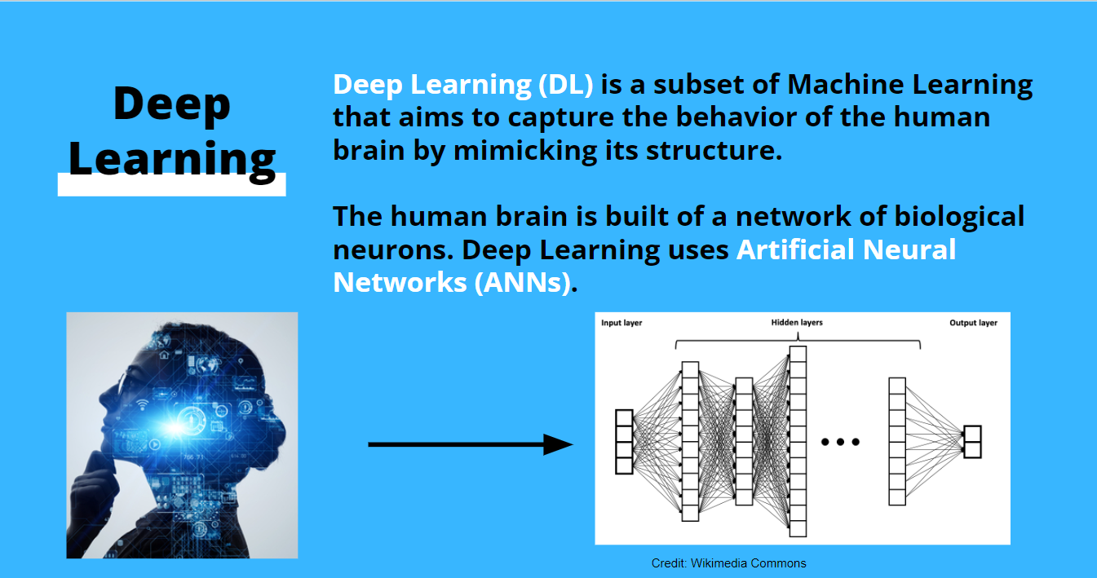
Deep Learning Definition

Slide 8









AI, ML, Deep learning?
Artificial intelligence (AI)
Any technique that allows computers to mimic human intelligence using logic, if-then statements, and machine learning
Machine learning (ML)
A subset of AI that uses machines to search for patterns in data to build logic models automatically
Deep learning (DL)
A subset of ML composed of deeply multi-layered neural networks that perform tasks like speech and image recognition
Generative AI
4
Powered by large models that are pretrained on vast corpuses of data and commonly referred to as foundation models (FMs)
© 2022, Amazon Web Services, Inc. or its affiliates. All rights reserved.

Slide 9
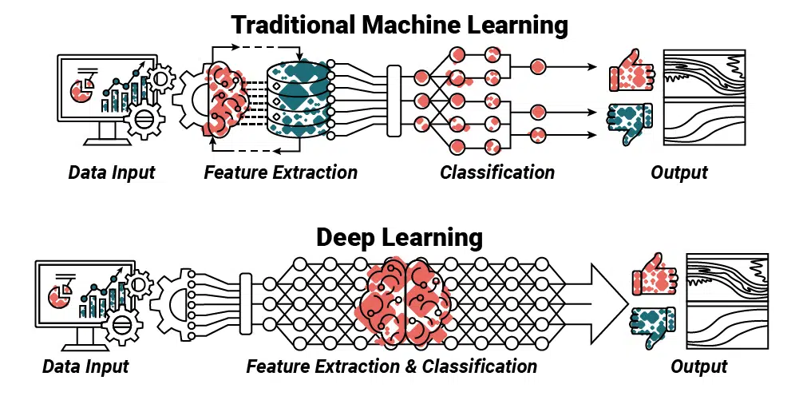
Traditional ML vs Deep Learning

Slide 10
ML Problem Vs DL Problem
What is the size of your data?
Deep Learning: Best for large datasets (e.g., millions of samples).
Traditional ML: Works well with small to medium-sized datasets.
What is the complexity of the task?
Deep Learning: Excels at complex tasks like image recognition, natural language processing, and speech recognition.
Traditional ML: Ideal for simpler problems like regression, basic classification, and tabular data.
Do you have the computational resources?
Deep Learning: Requires high computational power (e.g., GPUs, TPUs).
Traditional ML: Can run on standard computers with less hardware demand.
Do you need interpretability?
Traditional ML: Models like decision trees and logistic regression are easier to interpret.
Deep Learning: Often considered a "black box," harder to interpret but powerful.
Notes:
Rule of Thumb:
Start with traditional ML for small datasets or less complex problems.
Transition to deep learning when you have big data, complex tasks, or sufficient computational resources.
Examples:
Traditional ML: Predicting house prices, customer segmentation.
Deep Learning: Detecting cancer in medical images, creating chatbots.
Highlight trade-offs between interpretability and power when choosing between traditional ML and deep learning.

Slide 11
The Story Behind Deep Learning

Slide 12
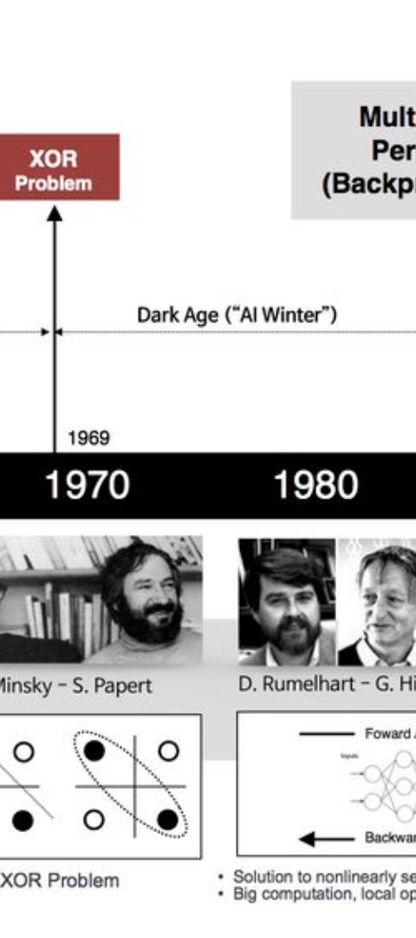
History and Evolution of Deep Learning
1
Early Beginnings
Deep learning traces its origins to the 1940s when the first neural network model, the perceptron, was introduced. Throughout the latter half of the 20th century, various researchers made significant contributions, laying the groundwork for the advancements to come.
2
Rise of Big Data
The late 2000s and early 2010s saw a surge in deep learning's progress, largely due to the availability of big data and advancements in computing power. This facilitated the training of deep neural networks on massive datasets, leading to breakthroughs in performance and accuracy.
3
Modern Era
In recent years, deep learning has proliferated across industries with the development of powerful architectures, algorithmic improvements, and widespread adoption of deep learning frameworks. This has led to the integration of deep learning into a multitude of applications.

Slide 13
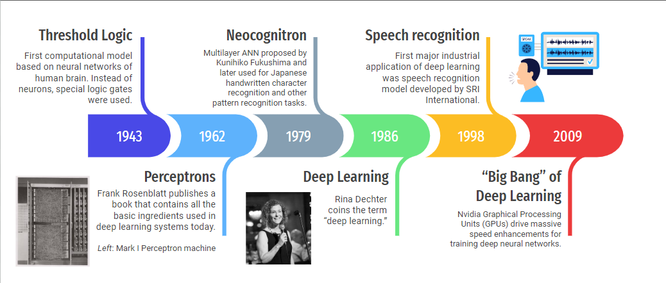
Deep Learning History – 1 of 2

Slide 14
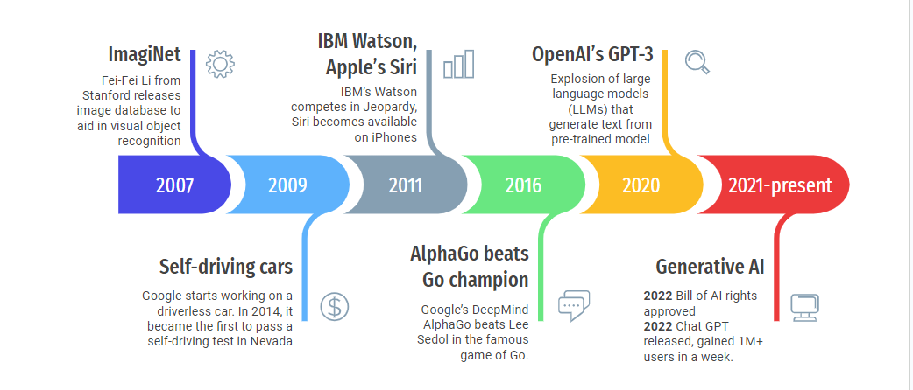
Deep Learning History – 2 of 2

Slide 15
Foundational Concepts of Deep Learning

Slide 16
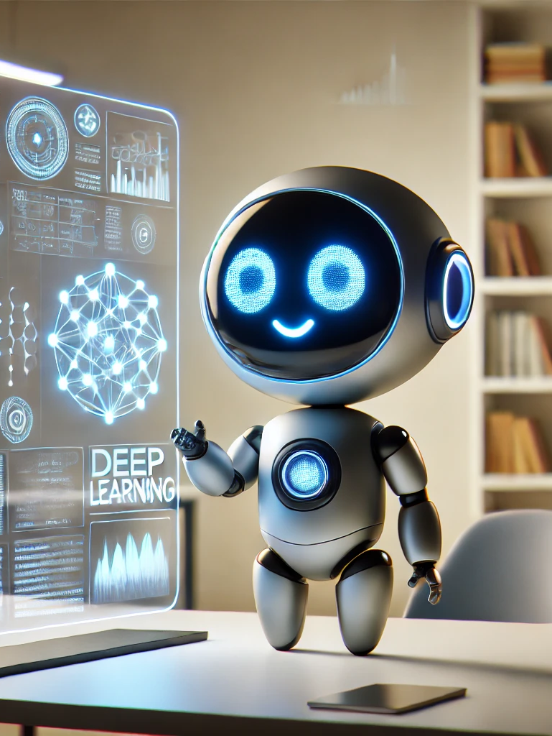
Key Terms in Deep Learning
Artificial Neuron: Basic unit mimicking biological neurons.
Backpropagation: Method for training neural networks.
Neural Networks: Structures mimicking the human brain's neuron connections.
Activation Function: Determines neuron output based on inputs.
Loss Function: Measures prediction error during model training.
Notes:
This are introduces key terms essential for understanding deep learning. An artificial neuron serves as the fundamental building block of neural networks. Backpropagation is the algorithm used to train these networks, while neural networks themselves are inspired by the human brain. Activation functions play a crucial role in determining outputs, and loss functions are used to gauge the model's accuracy throughout the training process.

Slide 17
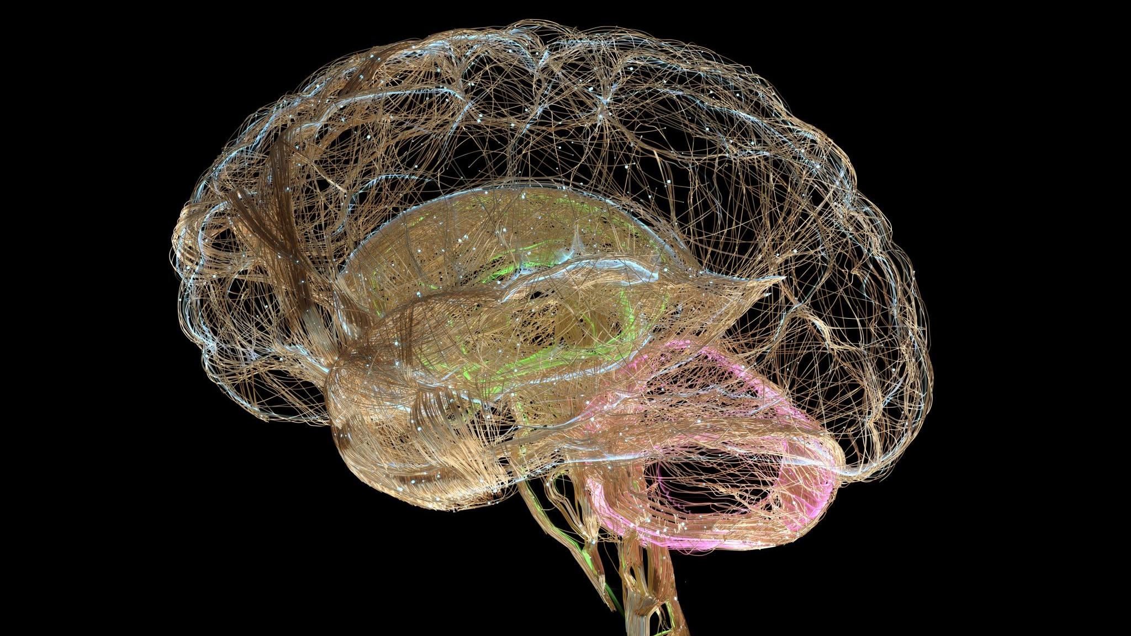
The human brain is composed of a very large number of “procession units” called Neurons, operating in parallel.
Notes:
Parallel Processing
The vast number of neurons and the even more numerous connections between them (synapses) enable the brain to perform many tasks simultaneously, known as parallel processing. Here are some key aspects:

Slide 18
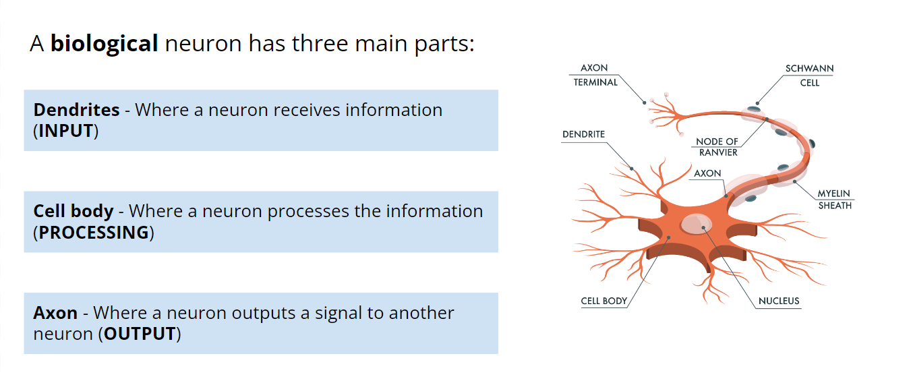
The Neuron

Slide 19
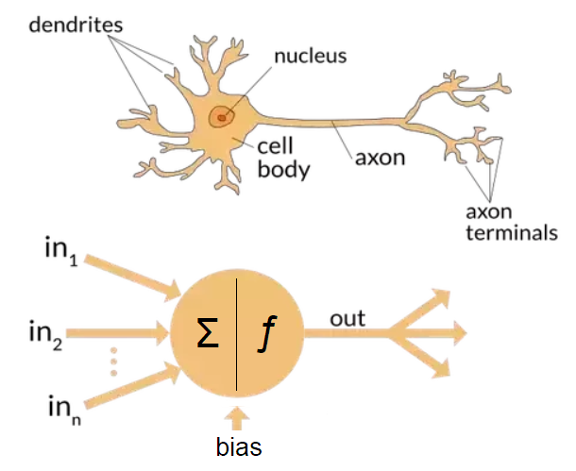
Artificial vs Biological Neuron

Slide 20

Parts of the Neuron: Technical
Notes:
generic neuron (node) has:
Inputs that are fed values from data or from neurons before it
Weights that are multiplied by these values to allow some inputs to be considered more than others and a bias that is the added to the sum of the weights
An Activation function that modifies the sum of weighted values that we choose, often to create non-linear relationships. The output of this activation function is provided to the next neurons or as an output of the whole model
Activation Function: Now comes the activation function. It takes the result from above and transforms it into a new number, usually between some range like 0 to 1, or -1 to 1.
The activation function helps the neural network make complex decisions. Without an activation function, each neuron would only be doing simple additions and multiplications, which limits what the network can learn. Activation functions introduce a touch of complexity and nuance, allowing the network to learn from errors and make better decisions or predictions.

Slide 21
Activation Functions: The Decision Makers
Think of Activation Functions Like...
Different Types of Decisions!
They help neurons decide:“
Should I pass this signal along?“
Just like how we make different types of decisions:
Yes/No decisions
Gradual choices
Balanced judgments

Slide 22
Common Activation Functions Made Simple
ReLU (Most Popular)
Like a bouncer at a club. Negative numbers? Stay out! (become zero).Positive numbers? Come right in! Simple and works great.
Sigmoid Like a dimmer switch.
Smoothly goes from 0 to 1. Good for probability decisions. How likely is this?
Tanh Like a mood scale
(-1 to +1).Similar to sigmoid but centered at zero. Good for expressing strong opinions. "Love it or hate it?

Slide 23
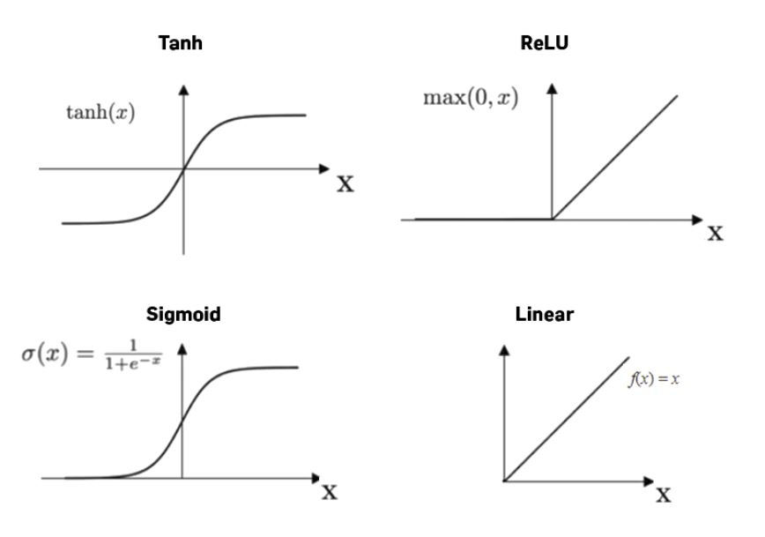
Choosing Activation Functions: "When to Use What?”
"ReLU: Your Default Choice
Works well most of the time.
Fast and simple.
Great for deep networks.
Sigmoid:
Probability Problems
When output needs to be 0-1.
Like yes/no decisions.
Useful for classification tasks.
Tanh:
When Balance Matters
When negative values are important.
Data centered around zero.
Notes:
ReLU: Like a flashlight - either off or bright.
Sigmoid: Like sunrise - gradual transition from dark to light.
Tanh: Like a review system from very negative to very positive.

Slide 24
The “Deep” in Deep Learning Model…
…Is the Artificial Neural Network, made of many connected (artificial) Neurons.

Slide 25
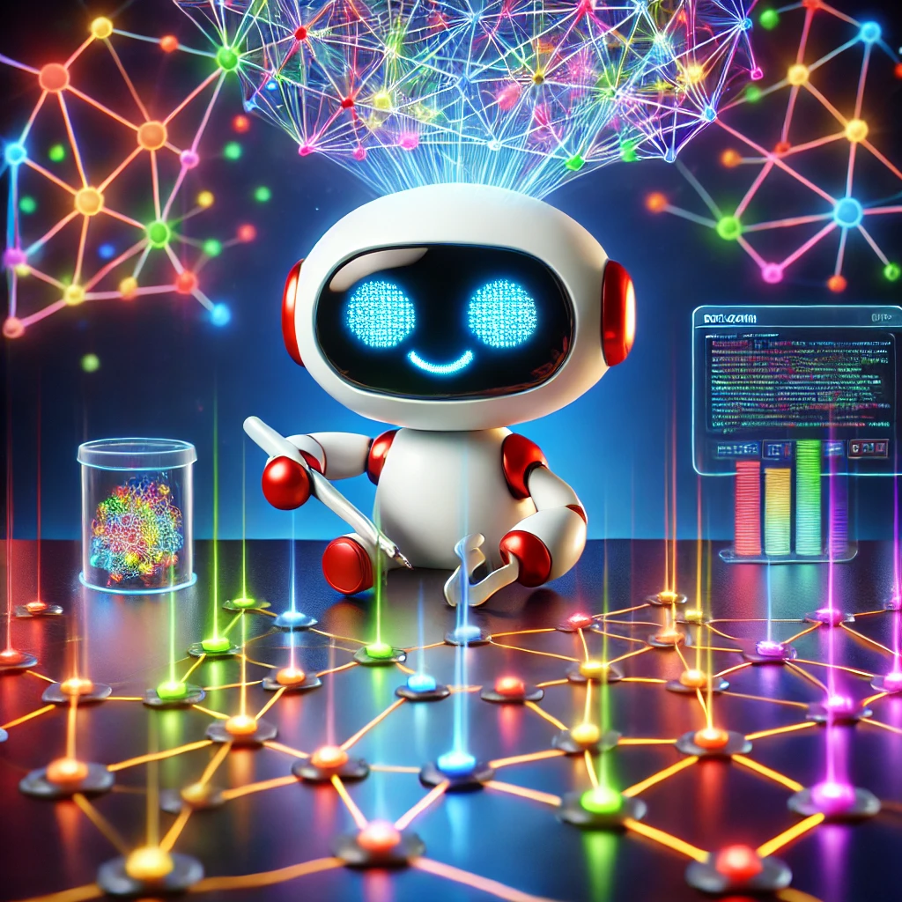
Building a Neural Network

Slide 26
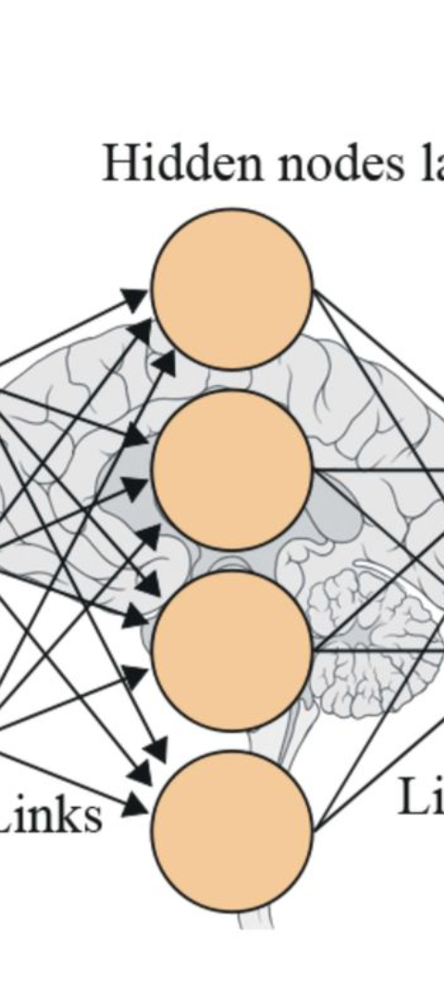



Neural Networks and Their Architecture
Input Layer
The input layer receives data and passes it to the hidden layers for processing and learning.
Hidden Layers
Hidden layers process the input data, applying weights and biases to produce an output.
Output Layer
The output layer produces the final result, which can include classification or prediction.
Notes:
Note that in a Neural Network we just feed data to the NN and it creates the weights and biases using a process called backpropagation.
The input data is fed into the network, and the output of the network is calculated.
The loss function is calculated by comparing the output of the network to the desired output.
The gradient of the loss function with respect to the network weights and biases is calculated.
The network weights and biases are updated in a way that reduces the loss.
Steps 1-4 are repeated until the network reaches a desired level of performance.

Slide 27


Slide 28
Backpropagation: How Neural Networks Learn from Mistakes
Prediction Made: Example: "This image is a cat" ➔ Wrong! It's a dog.
Error Propagates Backward: Like retracing steps in a game of telephone to identify where the message got distorted.
Small Adjustments Applied: Fine-tuning the system, like adjusting radio knobs, until the "signal" (accuracy) is clear.
Key Point: Learning happens by correcting mistakes and refining predictions through backward adjustments.

Slide 29
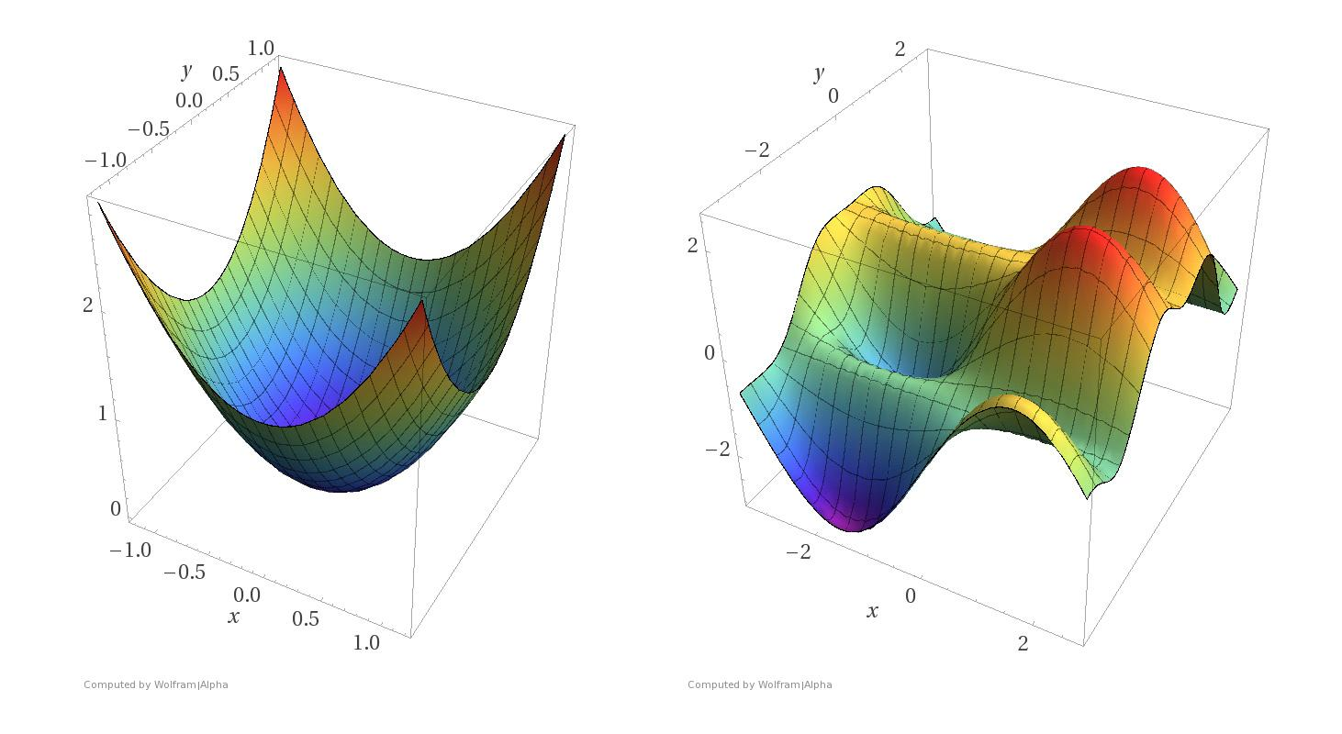
Gradient Descent
Optimization algorithm for finding minimal loss
Steps:
Calculate prediction error
Compute gradients
Update weights
Repeat until convergence
Types: Batch, Mini-batch, Stochastic
Challenges: Learning rate, Local minima
Notes:
Types of Learning: Batch Sizes Matter!
1. Batch Learning
• Like studying an entire textbook before taking a quiz
• Uses all training data at once
• Very accurate but slow
• Example: Learning from 50,000 images at once
2. Mini-Batch Learning
• Like studying one chapter at a time
• Uses small groups of data (e.g., 32 or 64 samples)
• Good balance of speed and accuracy
• Most commonly used in practice
• Example: Learning from 50 images at a time
3. Stochastic (One-by-One)
• Like studying one flashcard at a time
• Updates after each single example
• Fast but can be jumpy
• Example: Learning from 1 image at a time
This is often best taught with a visualization, so here's a suggested analogy:
Picture three different restaurant managers learning from customer feedback:
Batch: Reads all reviews once a month (thorough but slow)
Mini-Batch: Reviews feedback every evening (balanced approach)
Stochastic: Changes things after each customer (quick but might overreact)
Understanding when to use each:
Use Batch when accuracy is crucial and you have plenty of computing power
Use Mini-Batch for most real-world applications (it's the sweet spot)
Use Stochastic when you need real-time learning or have limited memory
Local Minima
Understanding Local Minima
The Valley Problem
- Imagine a hiker looking for the lowest point
- They might stop at a small valley (local minimum)
- But miss the deeper valley (global minimum)
- Neural networks can face the same challenge!
Solutions:
- Take bigger steps sometimes (momentum)
- Try different starting points
- Use "energy" to climb out of small valleys

Slide 30
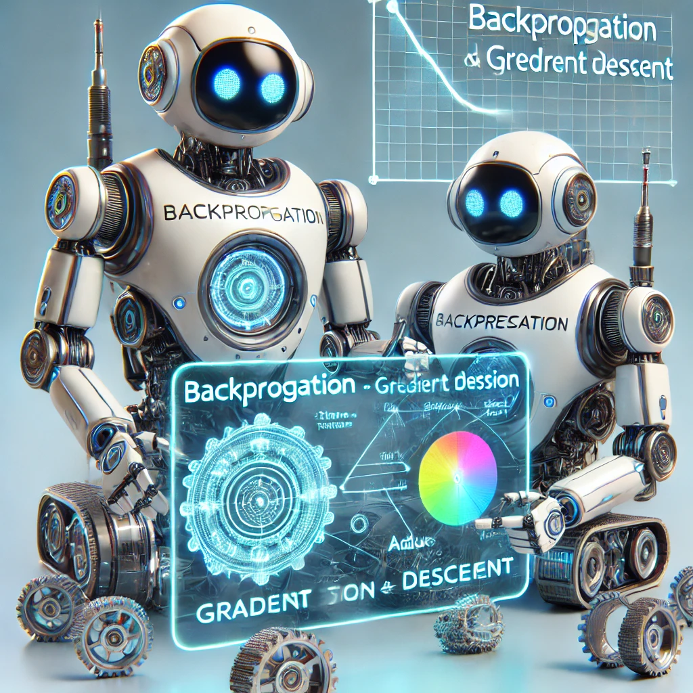
Backpropagation & Gradient Descent: Partners in Learning
Gradient Descent = The Strategy
Finding the best way to improve.
Deciding how big the changes should be.
Moving toward better performance.
Backpropagation = The Feedback System
Figuring out what went wrong.
Identifying who needs improvement.
Passing feedback to all players.
Together They Work Like This:
Team plays the game (Forward Pass).
Coach analyzes mistakes (Backpropagation).
Team adjusts their play (Gradient Descent).
Repeat until they're champions!
Notes:
"How They Work Together"
The Learning Dance:
Backpropagation Says:
"Here's what each part of the network did wrong" (Like a teacher marking a test).
Gradient Descent Decides:
"Here's how much to change each part" (Like deciding how much practice each skill needs).
Together They:
Find the mistakes (Backpropagation).
Fix the mistakes (Gradient Descent).
Make small, smart improvements.
Lead to better results.
Visual Analogy:
Learning to Park a Car
Backpropagation: "You're too far to the left" (Identifies the problem).
Gradient Descent: "Turn the wheel right by 15 degrees" (Decides how much to adjust).
Result: Perfect parking through small, informed adjustments.
Speaker Notes:
Key Analogies to Share:
Cooking Example:
Backpropagation: Tasting and identifying "too salty."
Gradient Descent: Deciding to use 1/2 teaspoon less salt next time.
Navigation Example:
Backpropagation: "We went the wrong way."
Gradient Descent: "Let's adjust our route by taking this turn."
Learning an Instrument:
Backpropagation: Hearing wrong notes.
Gradient Descent: Making smaller finger movements.

Slide 31
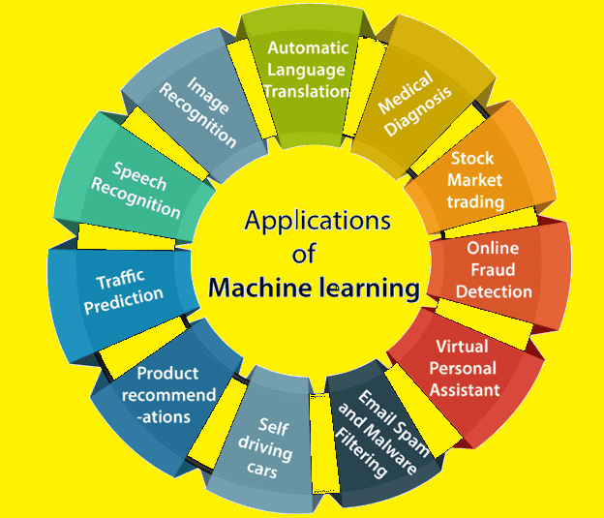
Applications of Deep Learning

Slide 32
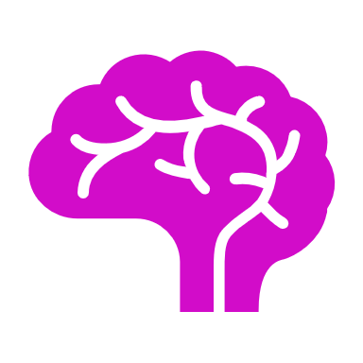
Key Takeaways from Deep Learning
Deep Learning leverages neural networks for complex tasks.
AI, ML, and DL are interconnected yet distinct fields.
Successful deep learning requires extensive data and computational power.
Activation functions play a crucial role in neural network performance.
Backpropagation and gradient descent are essential for model training.
Notes:
This slide summarises the fundamental concepts from our deep learning presentation. It highlights the interrelationships among AI, machine learning, and deep learning while emphasizing the importance of data, computational resources, and critical functions like activation and backpropagation. These takeaways will aid in grasping the core principles of deep learning.

